Slide 1



AI-Powered Fake News Detection Using Text Classification
Machine Learning | Natural Language Processing
Presented By :
Student Name : Aakash Institute Name: VIPS-TC Institute Roll no.: 04517702723 Enrollment no.: 775314
Summer Internship Program in AI & ML 2026 | Indian Institute of Computing and Technology (IICT)

Slide 2
Problem Statement & Project Objective
Problem Statement
Every day, many news articles are shared on the internet.
Some news articles are real, but some are fake.
It is difficult and time-consuming to check every news article manually.
We need an AI system that can quickly identify whether a news article is Real or Fake.
Why It Is Important ?
Online News
Social Media
Fake Information
AI Detection
Project Objective
To build a Machine Learning model that can automatically classify news articles as Real or Fake using Natural Language Processing (NLP) and compare different machine learning models to find the best one.
Summer Internship Program in AI & ML 2026 | Indian Institute of Computing and Technology (IICT)

Slide 3
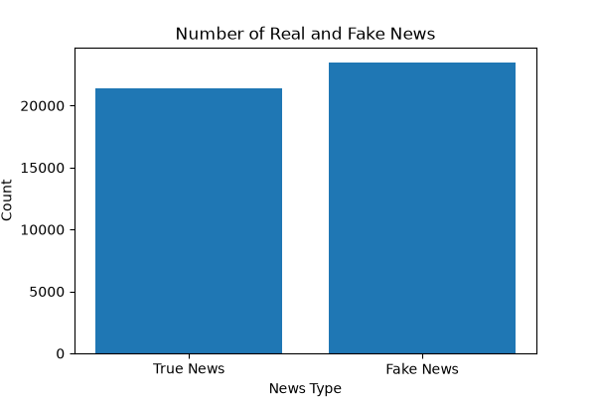
Dataset Overview
Dataset Summary
Real News = 21,417
Fake News = 23,502
Total Records = 44,919
Total Features = 5
Features Used
Title
Text
Subject
Date
Label (Real / Fake)
Source: Kaggle Fake News Dataset
Key Observation
The dataset is almost balanced.
Fake News has slightly more records than Real News.
A balanced dataset helps train a better model.
Summer Internship Program in AI & ML 2026 | Indian Institute of Computing and Technology (IICT)

Slide 4
DATA PREPROCESSING
Data Cleaning Steps
Checked missing values
Removed duplicate records
Combined Real and Fake news datasets
Converted text to lowercase
Removed special characters
Removed stop words
Combined Title + Text into one content column
Workflow
Raw Dataset
Missing Value Check
Duplicate Removal
Merge Dataset
Text Cleaning
Feature Ready Dataset
Output Clean and processed dataset ready for feature extraction.
Summer Internship Program in AI & ML 2026 | Indian Institute of Computing and Technology (IICT)

Slide 5
FEATURE ENGINEERING USING NLP
News Article
Text Cleaning
Bag of Words (BoW)
TF-IDF
Feature Matrix
Machine Learning Models
Output
Convert text into numbers
TF-IDF gives more importance to meaningful words
TF-IDF used for model training .
Summer Internship Program in AI & ML 2026 | Indian Institute of Computing and Technology (IICT)

Slide 6

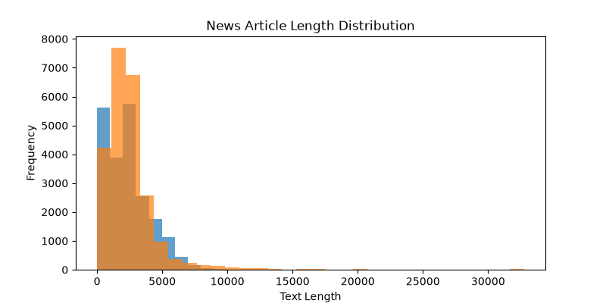
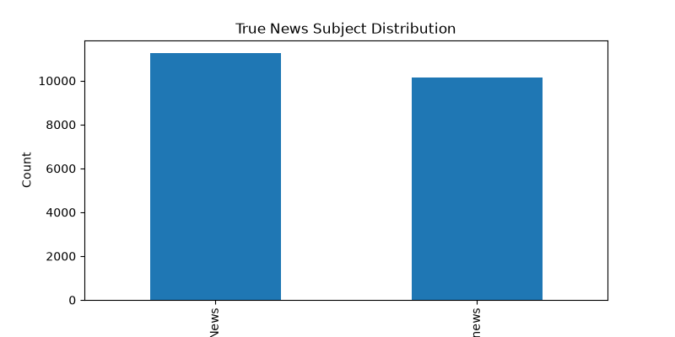
EXPLORATORY DATA ANALYSIS (EDA)
Key Insights
Real vs Fake News Distribution
Most Common News Categories
Average Article Length
Summer Internship Program in AI & ML 2026 | Indian Institute of Computing and Technology (IICT)

Slide 7
MACHINE LEARNING WORKFLOW
Dataset
Data Preprocessing
TF-IDF Feature Extraction
Train-Test Split
Train ML Models
Evaluate Performance
Best Model Selection
Summer Internship Program in AI & ML 2026 | Indian Institute of Computing and Technology (IICT)

Slide 8
MACHINE LEARNING MODELS
Logistic Regression
(Linear Classifier)
Naive Bayes
(Probability Based)
Model Selection Strategy
Same Dataset
Same TF-IDF Features Same Train/Test Split
Compare Accuracy of All Models
KNN (Distance Based )
Random Forest (Ensemble Learning)
Neural Network (MLP) (Deep Learning Approach )
Summer Internship Program in AI & ML 2026 | Indian Institute of Computing and Technology (IICT)

Slide 9
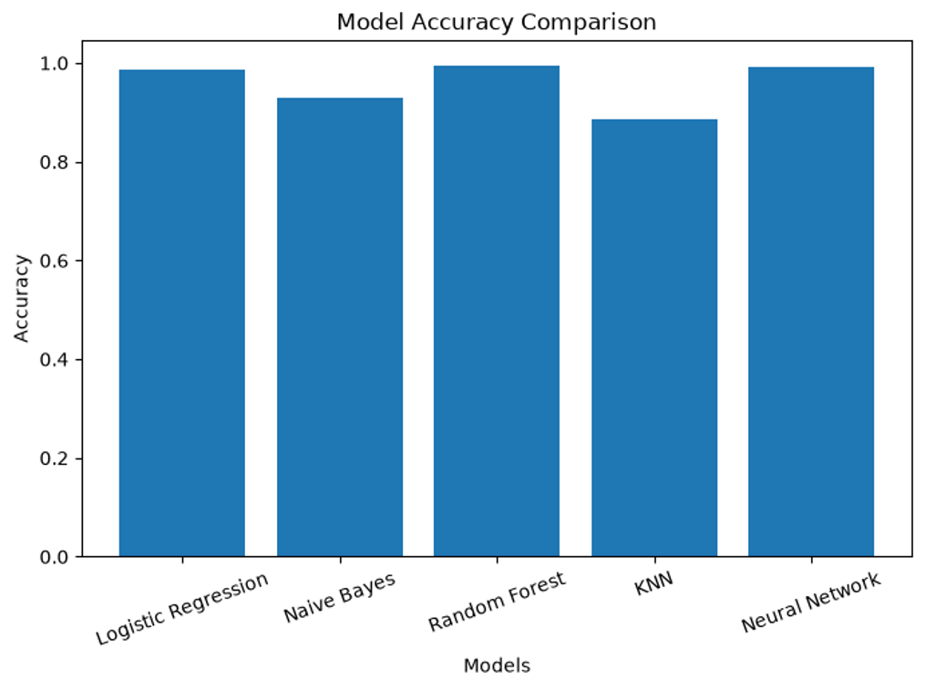
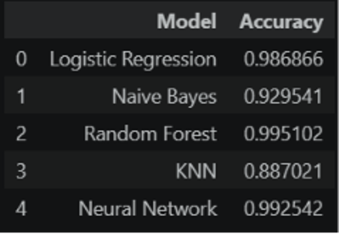
MODEL PERFORMANCE COMPARISON
Best Model
Highest Accuracy
Better Prediction Performance
Selected as Final Model
Summer Internship Program in AI & ML 2026 | Indian Institute of Computing and Technology (IICT)

Slide 10

BEST MODEL & FINAL RESULTS
Final Outcome
News Article
Random Forest Model
Real News / Fake News
BEST MODEL
Why Random Forest?
Highest Accuracy
Better Generalization
More Reliable Predictions
Selected as Final Model
Summer Internship Program in AI & ML 2026 | Indian Institute of Computing and Technology (IICT)

Slide 11
REAL-WORLD APPLICATIONS
Social Media
(Detect fake posts)
News Websites
(Verify published news)
Fact Checking
(Support fact-checkers)
News Applications (Alert users about fake news)
Government (Reduce misinformation)
Education & Research (Study fake news patterns )
Summer Internship Program in AI & ML 2026 | Indian Institute of Computing and Technology (IICT)

Slide 12
FUTURE SCOPE
Multilingual News Detection
Mobile Application
Browser Extension
Real-Time News Detection
Advanced NLP Models (BERT / Transformer)
Cloud Deployment
Summer Internship Program in AI & ML 2026 | Indian Institute of Computing and Technology (IICT)

Slide 13
CONCLUSION
Problem Identified
Data Prepared & Cleaned
Multiple ML Models Trained
Random Forest Selected
Fake News Successfully Classified
PROJECT ACHIEVEMENT
Successfully built a Fake News Detection System
Compared multiple Machine Learning models
Achieved high prediction accuracy
Project objective successfully achieved
Random Forest Accuracy: 99.51%
The project objective was successfully achieved by building an AI-based Fake News Detection System with high accuracy.
Summer Internship Program in AI & ML 2026 | Indian Institute of Computing and Technology (IICT)

Slide 14
THANK YOU
Summer Internship Program in AI & ML 2026 | Indian Institute of Computing and Technology (IICT)

